Slide 1
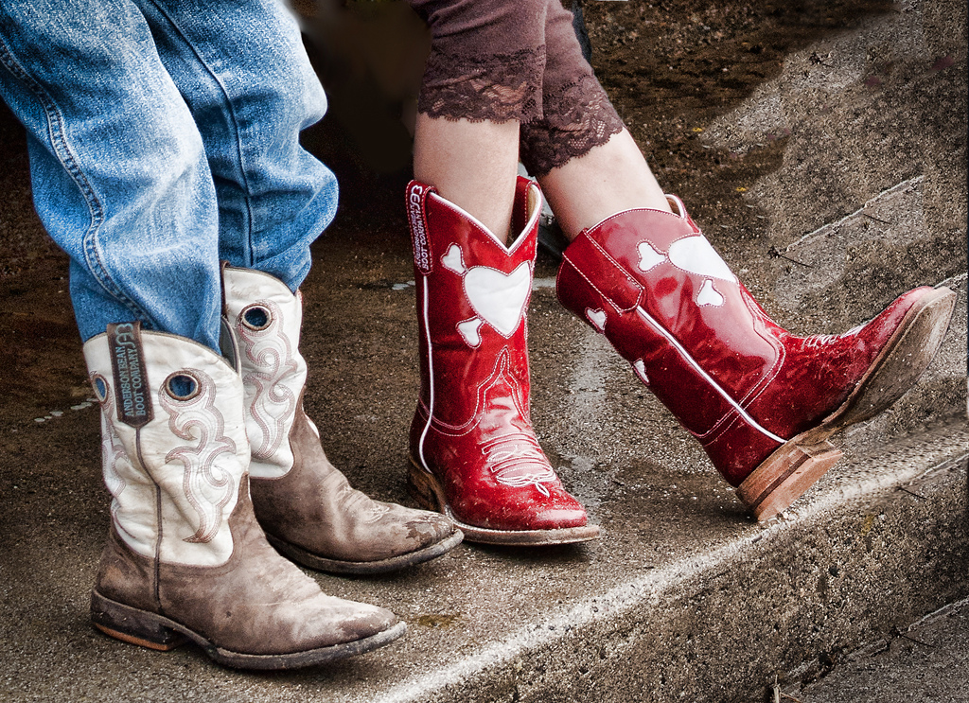

Gender
[Instructor Name]
[Class and Section Number]
Notes:
Given that you can compound the lecture on gender with a few classroom activities and demonstrations, we recommend breaking it up into two class periods.
Warm-up: This humorous video provides a great icebreaker to get students talking about gender differences. It nicely illustrates coping differences. Video link (approximately 2 min): https://www.youtube.com/watch?v=-4EDhdAHrOg.
Discussion question: How does this video illustrate common gender stereotypes?
Answers will vary, but students should be able to point out that this illustrates the common stereotype that men try to be “fixers” and women have a need to communicate their problems aloud.

Slide 2
Overview
Introduction to Terminology
Gender Differences
Gender Roles
Gender Sexism and Socialization
Notes:
The purpose of this slide is to provide students with an overview of the material that will be covered during the lecture.
Technical Note: These slides may contain simple click animation so that you can focus students’ attention on a particular question, a selection of text, or an image and not have them be distracted by reading ahead. You can either preview the sequence of animation by going through the slides in slideshow view, visiting the animations tab, or reviewing the slide notes. In the notes you will see a cue - (Click) – that corresponds to each animation.
You will also find hyperlinks to outside videos at various places in the slides. These hyperlinks are embedded in text and indicated by color and in the notes section.

Slide 3



Introduction to Terminology
Sex Gender
Notes:
This slide operationally defines two related concepts: sex and gender.
Suggested activity: Request that students generate a list of attributes that they associate with masculinity and femininity. They may want to do this individually or in pairs or groups. This, as well as a discussion of the origins of their opinions regarding these attributes (i.e., Why they feel these represent masculinity or femininity), can illustrate the complexity of gender construction before moving on to discuss the difference between “sex” and “gender”.
Discussion questions: What do you think the difference is between the terms “sex” and “gender”?
Answers may vary; although students should be introduced to this information during their reading.
Instructor’s note: Make sure to clearly differentiate between these two frequently conflated terms. The terms “sex” and “gender” are frequently used interchangeably, though they have different meanings:
Sex refers to the biological category of male or female, as defined by physical differences in genetic composition and in reproductive anatomy and function.
Gender refers to the cultural, social, and psychological meanings that are associated with masculinity and femininity (Wood & Eagly, 2002).
You can think of “male” and “female” as distinct categories of sex (a person is typically born a male or a female), but “masculine” and “feminine” as continuums associated with gender (everyone has a certain degree of masculine and feminine traits and qualities).

Slide 4
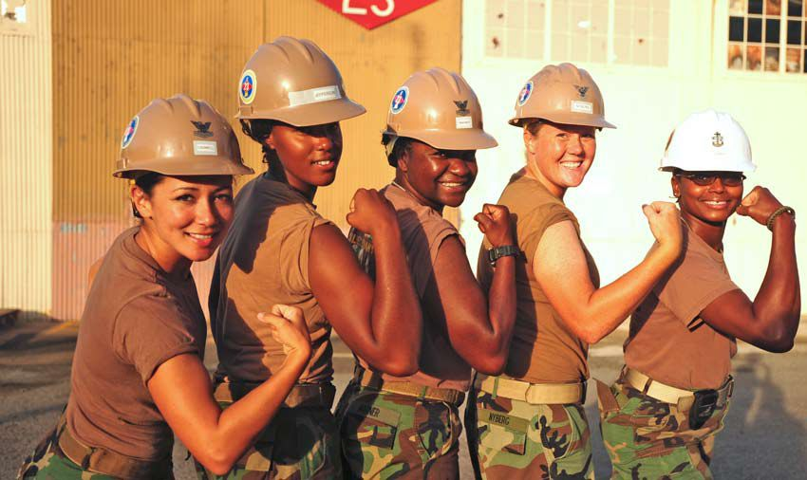
Introduction to Terminology
Gender Roles – Behaviors, attitudes, and traits designated as masculine or feminine in a culture - based on gender stereotypes.
Notes:
This slide formally introduces/defines two terms that are frequently misunderstood: gender roles and gender stereotypes.
Lecture Info:
Beyond sex and gender, a number of related terms are also often misunderstood:
Gender roles are the behaviors, attitudes, and personality traits that are designated as either masculine or feminine in a given culture.
In American culture, we commonly think of gender roles in terms of gender stereotypes, or the beliefs and expectations people hold about the typical characteristics, preferences, and behaviors of men and women.
Discussion question: How might gender stereotypes perpetuate gender roles?
One answer: People act out the stereotypes they believe to be valid or true.

Slide 5

Introduction to Terminology
Gender Identity – Psychological sense of being male or female
Sexual Orientation – Direction of one’s emotional and erotic attraction to opposite, same, or both sexes
Notes:
This slide introduces and defines two more key concepts: gender identity and sexual orientation.
Instructor’s note: You should differentiate gender identity (the psychological sense of being male or female) from sex (biological gender) and gender (constructed by external, societal forces).
A person’s gender identity refers to their psychological sense of being male or female.
In contrast, a person’s sexual orientation is the direction of their emotional and erotic attraction toward members of the opposite sex, the same sex, or both sexes.
These are important distinctions, and though we will not discuss each of these terms in detail, it is important to recognize that sex, gender, gender identity, and sexual orientation do not always correspond with one another. A person can be biologically male but have a female gender identity while being attracted to women, or any other combination of identities and orientations.

Slide 6
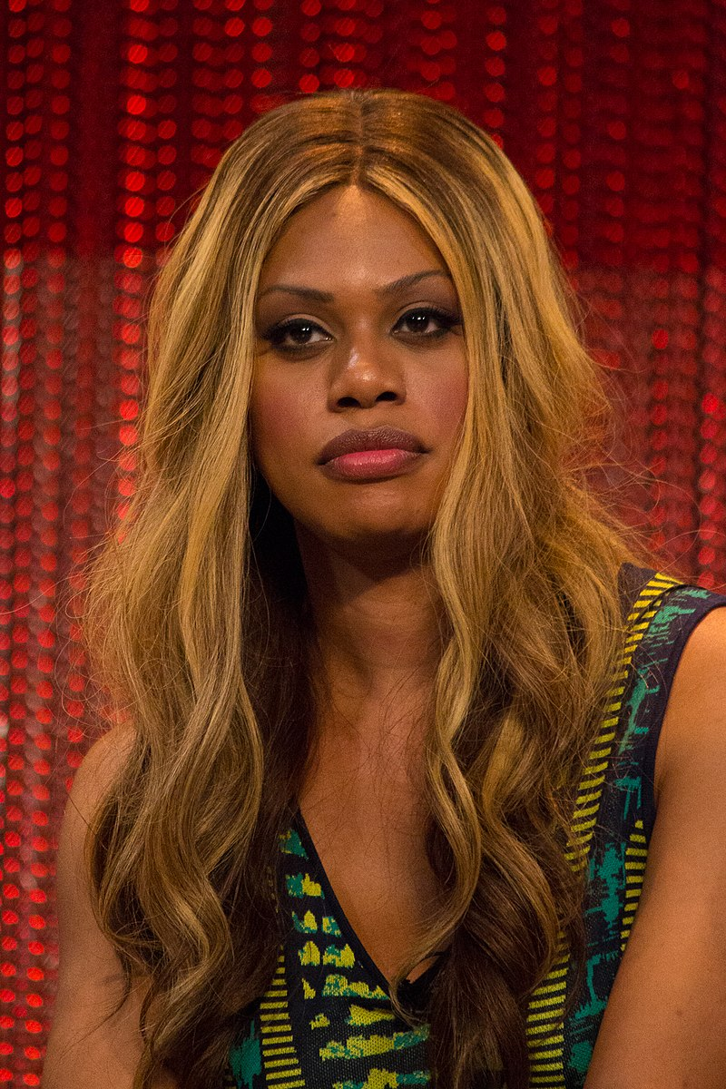
Introduction to Terminology
The Gender Continuum:
Masculinity to Feminity – people can identify along this continuum or be fluid among this continuum
Notes:
This slide introduces and defines key concepts: cisgender, transgender, genderqueer or gender non-binary, genderfluid, agender and bigender
Instructor’s note: You should differentiate between the new terms being introduced at this point in the lecture:
Cisgender - A term used to describe individuals whose gender matches their biological sex.
Transgender - A term used to describe individuals whose gender does not match their biological sex.
Genderqueer or Gender Non-Binary - An umbrella term used to describe a wide range of individuals who do not identify with and/or conform to the gender binary.
Genderfluid - An individual who may identify as male, female, both, or neither at different times and in different circumstances.
Agender - An individual who may have no gender or may describe themselves as having a neutral gender.
Bigender - An individual who identifies as two genders.

Slide 7
Overview
Introduction to Terminology
Gender Differences
Gender Roles
Gender Sexism and Socialization
Notes:
The purpose of this slide is to provide students with an overview of the material that will be covered during the lecture.

Slide 8

Gender Differences
Gender Differences due to:
Actual Gender Differences
Gender Roles
Gender Stereotypes
Notes:
This slide leads a discussion regarding three different reasons gender differences are perceived to exist:
(Click) They actually exist (actual gender differences: i.e., men and women are actually different in some abilities)
(Click) Gender roles (i.e., differences in how men and women are supposed to act)
(Click) Gender stereotypes (i.e., differences in how we think men and women are) Sometimes gender stereotypes and gender roles reflect actual gender differences, but sometimes they do not.
Instructor’s note: Students often have a difficult time understanding the difference between gender roles and gender stereotypes. Students report that it is helpful to conceptualize gender roles as the manifestation of gender stereotypes. Essentially, gender roles refer to how things are, which are influenced by how we think things should be (i.e., gender stereotypes.)
Discussion question: When have you experienced or witnessed gender stereotypes affecting gender roles?

Slide 9

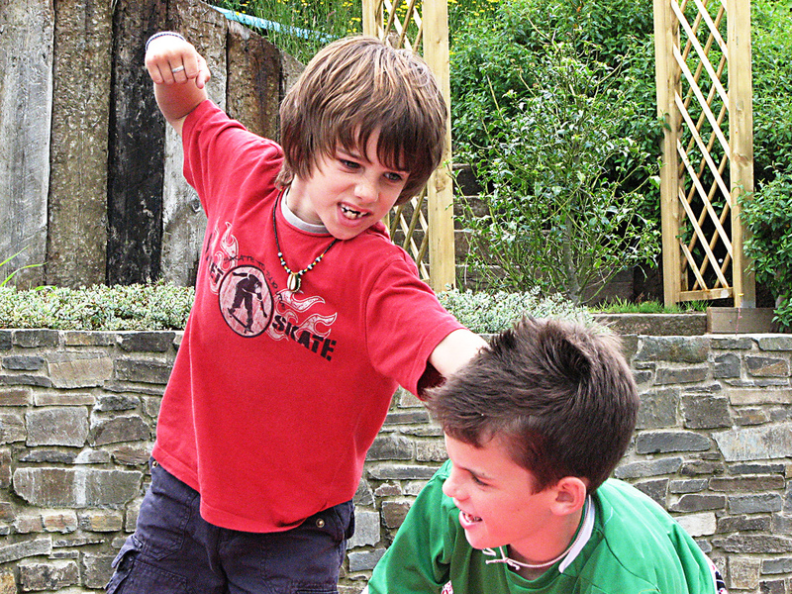
Gender Differences
Girls more likely to:
Agree with person they are talking to
Offer praise
Elaborate on other’s comments
Boys more likely to:
Assert their opinions
Offer criticism
Engage in aggression
Notes:
This slide leads a discussion regarding a few actual gender differences that are frequently found within the literature.
Discussion question: What kinds of behaviors do you tend to attribute to girls?
Answers:
(Click) Agree with person they are talking to
(Click) Offer praise
(Click) Elaborate on other’s comments
Discussion question: What behaviors do you tend to associate with boys?
(Click) Assert their opinions
(Click) Offer criticism
(Click) Engage in aggression
Instructor’s note: When leading this discussion, you may choose to ask students the following questions:
Do you agree with these gender differences?
Have these proven true in your own experiences?
Can you think of specific examples of times when you have noticed these gender differences (within others and/or yourselves)?
Have you noticed yourselves or others behaving contradictory to these aforementioned gender differences?
Explanation: What are actual gender differences?
In terms of language and language skills, girls develop language skills earlier and know more words than boys; this does not, however, translate into long-term differences.
In terms of temperament, boys are slightly less able to suppress inappropriate responses and slightly more likely to blurt things out than girls (Else-Quest, Hyde, Goldsmith, & Van Hulle, 2006).
With respect to aggression, boys exhibit higher rates of unprovoked physical aggression than girls, but no difference in provoked aggression. (Hyde, 2005).
Some of the biggest differences involve the play styles of children. Boys frequently play organized rough-and-tumble games in large groups, while girls often play less physical activities in much smaller groups (Maccoby, 1998).
There are also differences in the rates of depression, with girls much more likely than boys to be depressed after puberty. After puberty, girls are also more likely to be unhappy with their bodies than boys.

Slide 10
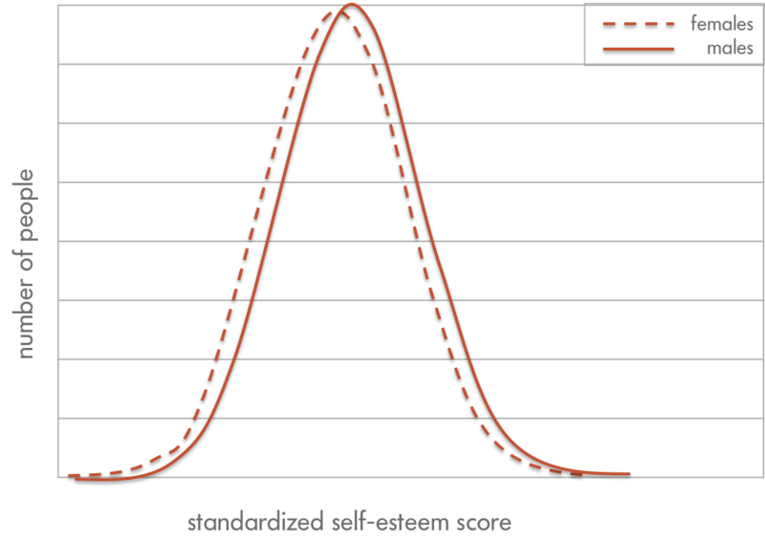
Gender Differences
Notes:
This slide shows that our perceived notions regarding the way in which males and females differ from one another are often not entirely accurate.
Instructor’s note: Point out what the pictured graph is illustrating: While our gender stereotypes paint males and females as drastically different from each other, even when a difference exists, there is considerable overlap in the presence of that trait between genders. This graph shows the average difference in self-esteem between boys and girls. Boys have a higher average self-esteem than girls, but the average scores are much more similar than different (Hyde, 2005).
Discussion question: What are some other examples of gender differences that seem prevalent but maybe aren’t?
Explanation: Even when there are mean level differences, the actual size of most of these differences is quite small. This means, knowing someone’s gender does not help much in predicting his or her actual traits.
Examples:
Activity level:
Boys are considered more active than girls. However, 42% of girls are more active than the average boy (but so are 50% of boys).
Spatial acuity (Many gender differences do not reflect innate differences, but instead reflect differences in specific experiences and socialization.):
One presumed gender difference is that boys show better spatial abilities than girls. However, Tzuriel and Egozi (2010) gave girls the chance to practice their spatial skills (by imagining a line drawing was different shapes) and discovered that, with practice, this gender difference completely disappeared.
Other common misconceptions (based on gender stereotypes and not actual differences):
Research has shown that girls are not more fearful, shy, or scared of new things than boys.
Boys are not more angry than girls and girls are not more emotional than boys.
Boys do not perform better at math than girls.
Girls are not more talkative than boys (Hyde, 2005).
Activity: (25-30 min.) End the class with either the “Assessing Assumptions about Gender” activity or the “Toy Story - Illustrating Gender Differences on a Motor Skills Task: In-Class Demonstration”. Both are likely to make lasting impressions upon your students and incite class discussion. For detailed instructions, see IM > Biology as a Basis of Behavior > Module 5: Gender > Activities/Demonstrations.

Slide 11

PART 2: GENDER
Notes:
This slide introduces the second class session focused on gender.
Warm-up: Begin your class with a review of last class’s activity/or demonstration. If you did not have enough time to have the end-of-class discussion in the last class, ask students to volunteer their thoughts at the beginning of the second class. This warm-up will lead right into a more detailed review of information on gender roles.

Slide 12
Overview
Introduction to Terminology
Gender Differences
Gender Roles
Gender Sexism and Socialization
Notes:
The purpose of this slide is to provide students with an overview of the material that will be covered during the lecture.

Slide 13
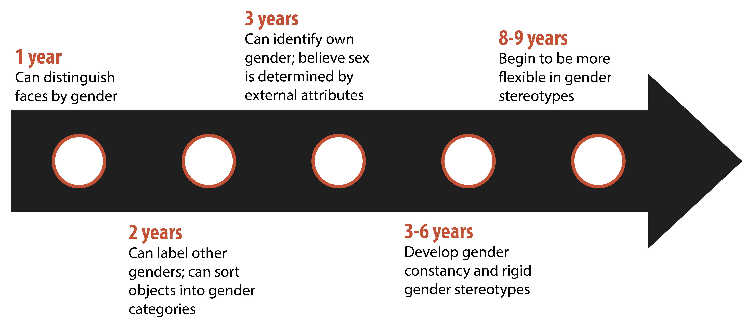
Gender Roles
Notes:
This slide explores the developmental trajectory of gender roles/gender stereotypes, and to emphasize how early children are able to understand gender and develop gender stereotypes. The picture serves to illustrate this point.
Instructor’s note: You may wish to ask students if they can recall one of their earliest moments when they feel they truly understood the concept of gender differences. Often, students will generate very meaningful/vivid events from their childhood, as well as humorous examples of very rigid gender stereotypes (ex. “When I was little, I thought only moms could do X and dads could do Y”). The latter can facilitate a discussion regarding if/how these gender stereotypes have become more flexible (disappeared fully) over time.
Lecture Info: As mentioned earlier, gender roles are well-established social constructions that may change from culture to culture and over time. In American culture, we commonly think of gender roles in terms of gender stereotypes, or the beliefs and expectations people hold about the typical characteristics, preferences, and behaviors of men and women. By the time we are adults, our gender roles are a stable part of our personalities, and we usually hold many gender stereotypes.
Explanation: When do children start to learn about gender? Very early.
By their first birthday, children can distinguish faces by gender.
By their second birthday, they can label others’ gender and even sort objects into gender-typed categories.
By the third birthday, children can consistently identify their own gender. At this age, children believe sex is determined by external attributes, not biological attributes.
Between 3 and 6 years of age, children learn that gender is constant and can’t change simply by changing external attributes, having developed gender constancy. During this period, children also develop strong and rigid gender stereotypes. Stereotypes can refer to play (e.g., boys play with trucks, and girls play with dolls), traits (e.g., boys are strong, and girls like to cry), and occupations (e.g., men are doctors and women are nurses).
These stereotypes stay rigid until children reach about age 8 or 9. Then they develop cognitive abilities that allow them to be more flexible in their thinking about others.

Slide 14
Gender Roles
Developmental Intergroup Theory - Adults’ heavy focus on gender leads children to:
Use gender as a key source of information about themselves and others
Seek out any possible gender differences
Form rigid stereotypes based on gender
Notes:
This slide introduces and defines the developmental intergroup theory, focusing on the impact that adults have on children within the context of gender.
Discussion questions: How might adults influence children’s behavior around gender roles and stereotypes? When have you witnessed this influence?
Explanation: Many of our gender stereotypes are so strong because we emphasize gender so much in culture (Bigler & Liben, 2007). For example, males and females are treated differently before they are even born. When someone learns of a new pregnancy, the first question asked is “Is it a boy or a girl?” Immediately upon hearing the answer, judgments are made about the child: Boys will be rough and like blue, while girls will be delicate and like pink.
Developmental intergroup theory postulates that adults’ heavy focus on gender leads children to
(Click) Pay attention to gender as a key source of information about themselves and others
(Click) Seek out any possible gender differences
(Click) Form rigid stereotypes based on gender that are subsequently difficult to change.

Slide 15
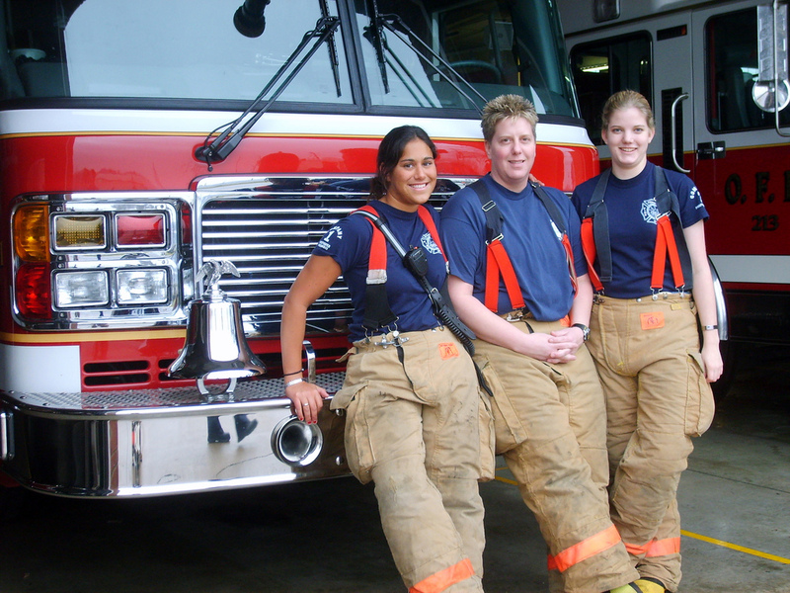
Gender Roles
Gender Schema Theory - Children actively organize others’ behavior, activities, and attributes into gender categories, which are known as schemas
Notes:
This slide introduces gender schema theory and the human need to categorize information (including gender). This is the first theory which attempts to explain the way in which children develop an understanding of gender roles. The second will be presented in the next slide.
Lecture info: Gender schema theory argues that children are active learners who essentially socialize themselves. In this case, children actively organize others’ behavior, activities, and attributes into gender categories, which are known as schemas. These schemas then affect what children notice and remember later. People of all ages are more likely to remember schema-consistent behaviors and attributes than schema-inconsistent behaviors and attributes.
Examples: People are more likely to remember men, and forget women, who are firefighters. They also misremember schema-inconsistent information. If research participants are shown pictures of someone standing at the stove, they are more likely to remember the person to be cooking if depicted as a woman, and the person to be repairing the stove if depicted as a man. By only remembering schema-consistent information, gender schemas strengthen more and more over time.

Slide 16
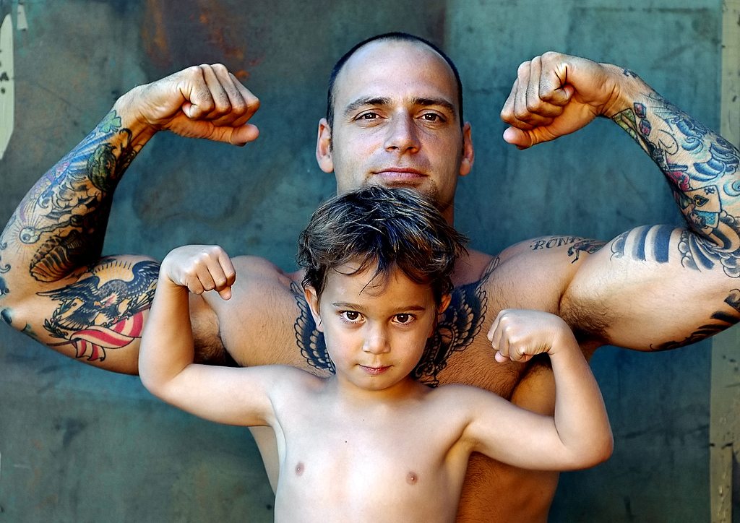
Gender Roles
Social Learning Theory - Gender roles are learned through reinforcement, punishment, and modeling
Notes:
This slide introduces the second theory of how children develop an understanding of gender roles: social learning theory.
Lecture Info: A second theory that attempts to explain the formation of gender roles in children is social learning theory. Social learning theory argues that gender roles are learned through reinforcement, punishment, and modeling. Children are rewarded and reinforced for behaving in concordance with gender roles and punished for breaking gender roles. In addition, social learning theory argues that children learn many of their gender roles by modeling the behavior of adults and older children and, in doing so, develop ideas about what behaviors are appropriate for each gender. Social learning theory has less support than gender schema theory—research shows that parents do reinforce gender-appropriate play, but for the most part treat their male and female children similarly (Lytton & Romney, 1991).
Discussion question: What are some examples of both gender schema theory and social learning theory that you have observed?
Activity/discussion: Play the video titled, “If women’s roles in ads were played by men”: https://www.youtube.com/watch?v=2SrpARP_M0o. Follow-up question: Is it odd to see men and women swap roles in portrayals by the video? If yes, why do you think that is?

Slide 17
Overview
Introduction to Terminology
Gender Differences
Gender Roles
Gender Sexism and Socialization
Notes:
The purpose of this slide is to provide students with an overview of the material that will be covered during the lecture.

Slide 18
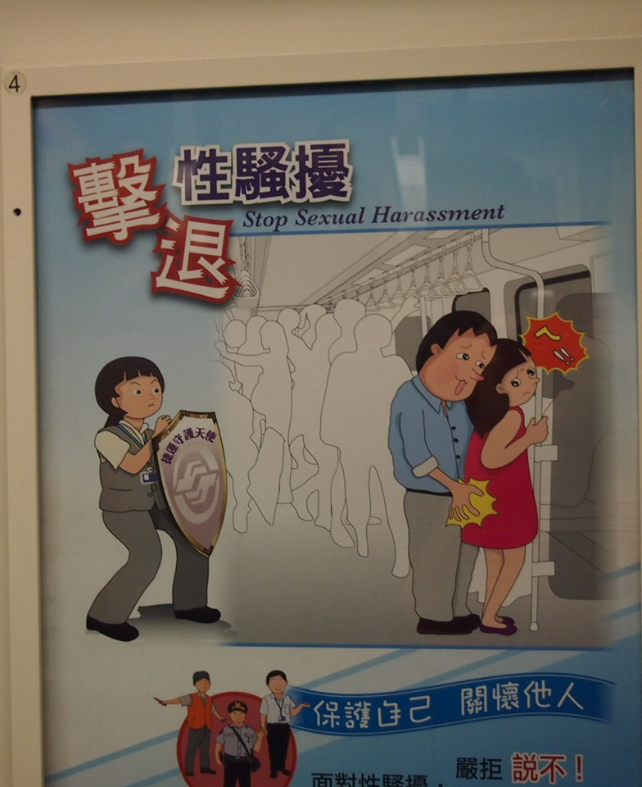
Gender Sexism & Socialization
Gender Discrimination – Differential treatment based on gender
Sexual Harassment – Unwanted treatment related to sexual behaviors or appearance
Notes:
This slide introduces and defines gender discrimination and sexual harassment, two ways in which the rights of others can be violated within the context of gender.
Discussion question: What are your thoughts about what constitutes gender discrimination and sexual harassment? Many students identify obvious examples of sexual harassment but have a harder time agreeing upon those that are less obvious. Some students often have direct experience with these concepts.
Explanation: Treating boys and girls, and men and women, differently is both a consequence of gender differences and a cause of gender differences. Differential treatment on the basis of gender is also referred to as gender discrimination and is an inevitable consequence of gender stereotypes. When it is based on unwanted treatment related to sexual behaviors or appearance, it is called sexual harassment. By the time boys and girls reach the end of high school, most have experienced some form of sexual harassment, most commonly in the form of unwanted touching or comments, being the target of jokes, having their body parts rated, or being called names related to sexual orientation.

Slide 19

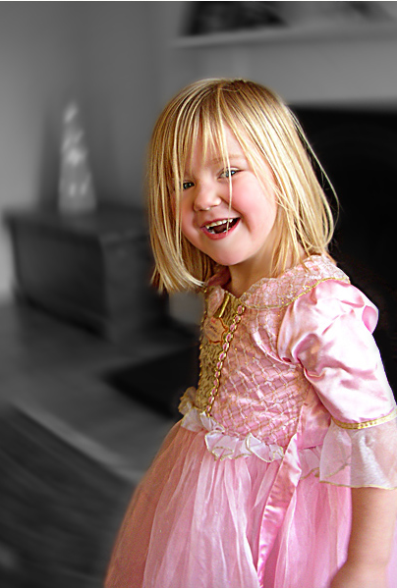
Gender Sexism & Socialization
Notes:
This slide facilitates a discussion regarding the way in which different gendered children are treated and socialized.
Discussion question: What types of behaviors do parents exhibit that encourage gender-stereotypical behavior? How might children reinforce these stereotypes themselves?
Explanation: A meta-analysis of research from the United States and Canada found that parents most frequently treated sons and daughters differently by encouraging gender-stereotypical activities (Lytton & Romney, 1991). Fathers, more than mothers, are particularly likely to encourage gender-stereotypical play, especially in sons. Parents also talk to their children differently based on stereotypes. For example, parents talk about numbers and counting twice as often with sons than daughters (Chang, Sandhofer, & Brown, 2011) and talk to sons in more detail about science than with daughters. Parents are also much more likely to discuss emotions with their daughters than their sons.
Children do a large degree of socializing themselves. By age 3, children play in gender-segregated play groups and expect a high degree of conformity. Children who are perceived as gender atypical (i.e., do not conform to gender stereotypes) are more likely to be bullied and rejected than their more gender-conforming peers.

Slide 20
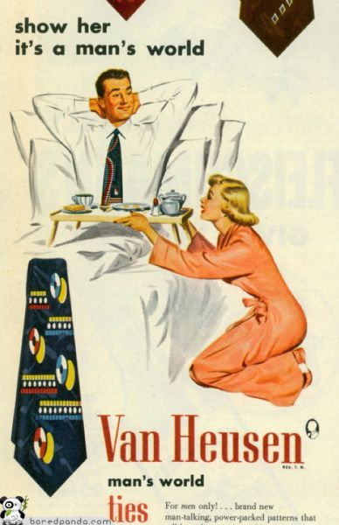
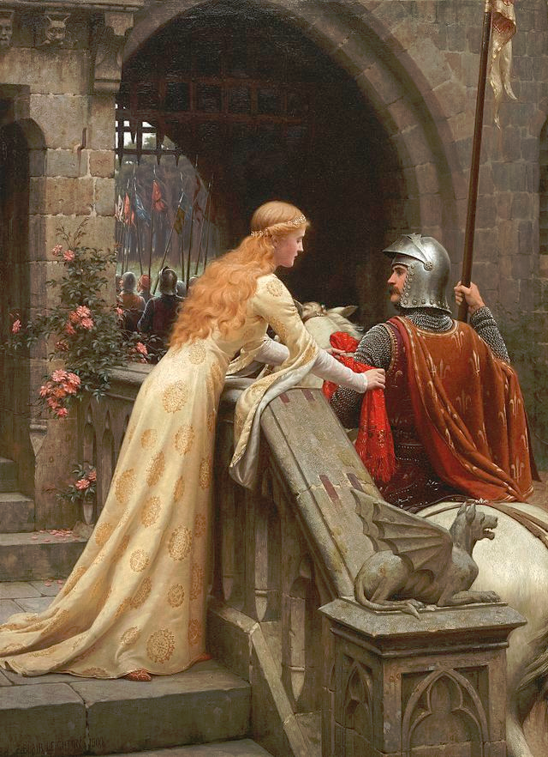
Gender Sexism & Socialization
Ambivalent Sexism - consists of two parts
Hostile Benevolent
Notes:
This slide introduces the concept of ambivalent sexism, and defines, provides examples of, and differentiates two forms of it: hostile and benevolent sexism.
Discussion question: Which of the images pictured here is most problematic or offensive? Why?
Explanation: Pictured on the left is an advertisement for Van Heusen which epitomizes hostile sexism, as the woman is portrayed as completely submissive to the male. Pictured on the right is a painting by Edmund Leighton entitled “God Speed!” which alludes to the portrayal of women as weak and in need of protection (i.e., benevolent sexism). Students will often have some differing opinions regarding whether or not benevolent sexism is problematic.
Discussion question: How do gender stereotypes affect sexism?
Explanation: Gender stereotypes typically maintain gender inequalities in society. The concept of ambivalent sexism recognizes the complex nature of gender attitudes, in which women are often associated with positive and negative qualities (Glick & Fiske, 2001). It has two components. First, hostile sexism refers to the negative attitudes of women as inferior and incompetent relative to men. Second, benevolent sexism refers to the perception that women need to be protected, supported, and adored by men. There has been considerable empirical support for benevolent sexism, possibly because it is seen as more socially acceptable than hostile sexism. Gender stereotypes are found not just in American culture. Across cultures, males tend to be associated with stronger and more active characteristics than females (Best, 2001).

Slide 21
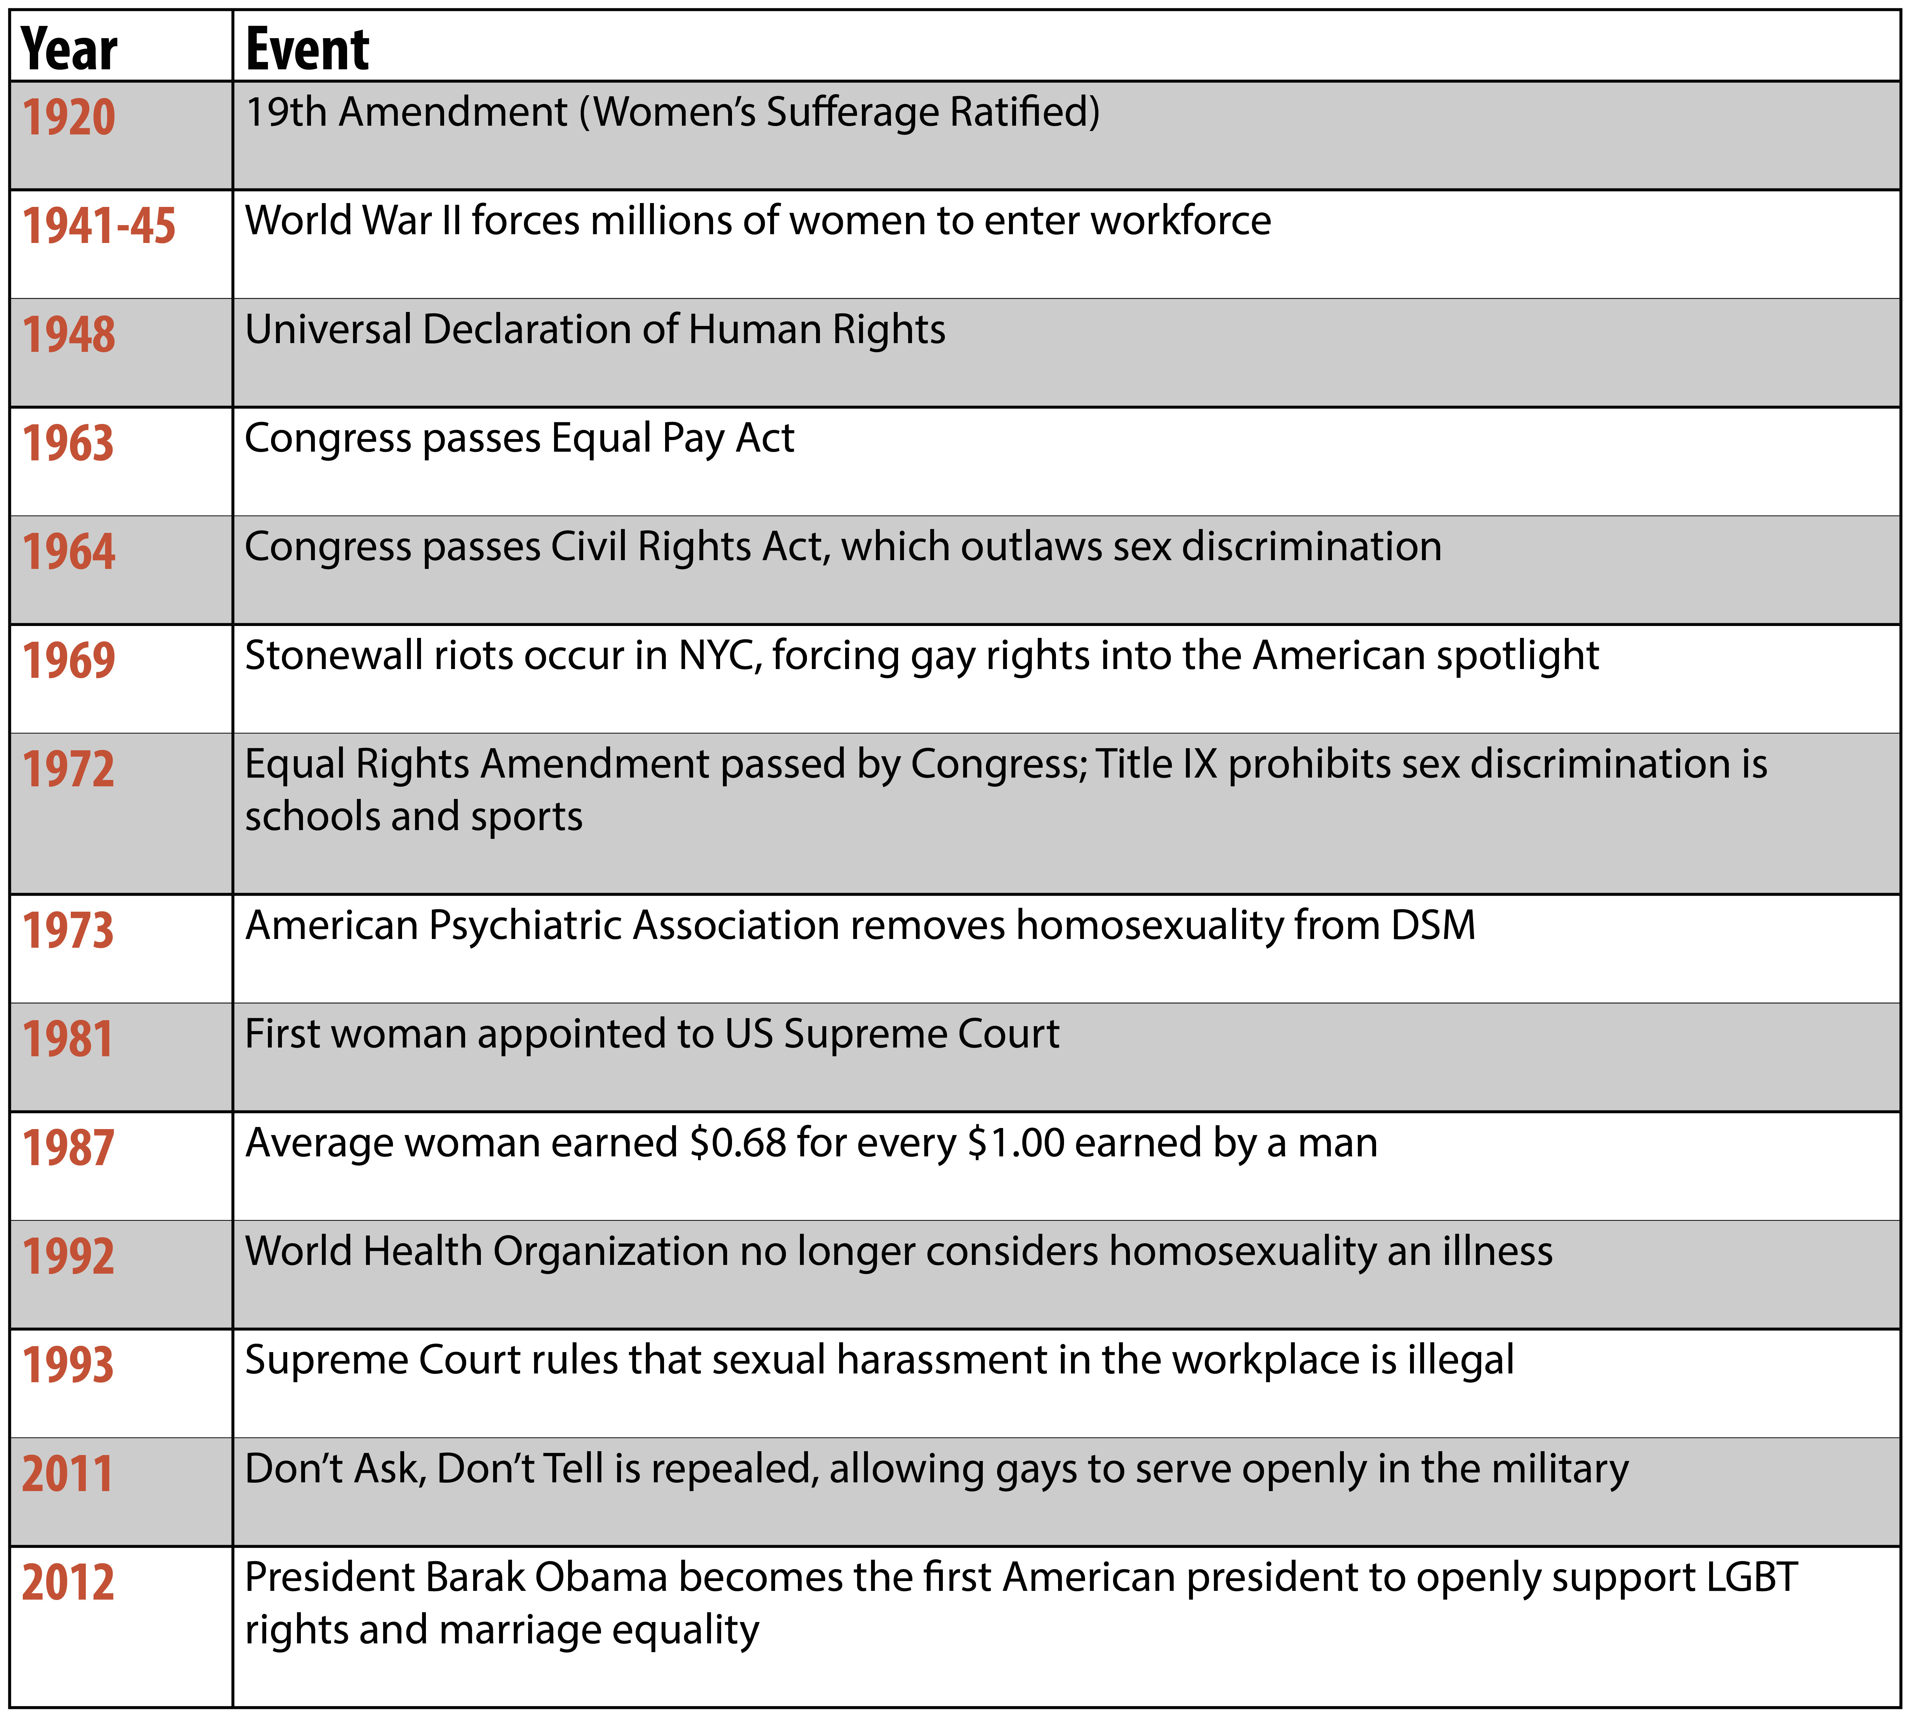
Gender Sexism & Socialization
Notes:
This slide concludes the lecture with a review of key events in the evolution of American sexism and socialization. Instructors teaching in other nations may wish to modify this slide to reflect key events within the country they are teaching (or the country of their students).
Discussion question: How have gender roles and their accompanying stereotypes changed in recent years?
Historical/cultural context: There has been an increase in children’s toys attempting to cater to both genders (such as Legos marketed to girls), rather than catering to traditional stereotypes. Nationwide, the drastic surge in acceptance of homosexuality and gender questioning has resulted in a rapid push for legal change to keep up with social change. Laws such as “Don’t Ask, Don’t Tell” and the Defense of Marriage Act (DOMA), both of which were enacted in the 1990s, have met severe resistance on the grounds of being discriminatory toward sexual minority groups and have been accused of unconstitutionality less than 20 years after their implementation. Change in perceptions of gender is also evident in social issues such as sexual harassment, a term that only entered the mainstream mindset in the 1991 Clarence Thomas/Anita Hill scandal. As society’s gender roles and gender restrictions continue to fluctuate, the legal system and the structure of American society will continue to change and adjust.
Activity: Magazines and Gender Roles: There are two magazines and gender roles activities. The first will take approximately 20-25 minutes; the second can be as short as 10-15 minutes. Depending on how much time you have available, ending the class with either of these activities will be a powerful way to complete the gender module. (For details of each activity, see IM > Biology as a Basis of Behavior > Module 5: Gender > Activities/Demonstrations).

Slide 22
Photo Attribution
Slide 1 | Photo Credit: e.b. image https://www.flickr.com/photos/13815852@N06/5902224553/ https://creativecommons.org/licenses/by-nc-nd/2.0/
Slide 3 | Photo Credit: http://commons.wikimedia.org/wiki/File:HeteroSym-pinkblue.svg http://en.wikipedia.org/wiki/en:public_domain
Slide 3 | Photo Credit: By Nemo http://pixabay.com/en/bodybuilder-muscles-man-make-295375/ http://creativecommons.org/publicdomain/zero/1.0/deed.en
Slide 3 | Photo Credit: By Nemo http://pixabay.com/en/black-outline-sexy-lady-silhouette-34895/ http://creativecommons.org/publicdomain/zero/1.0/deed.en
Slide 4 | Photo Credit: http://upload.wikimedia.org/wikipedia/commons/f/f4/Female_seabees_in_Guantanamo_-a.jpg http://en.wikipedia.org/wiki/public_domain
Slide 5 | Photo Credit: mrhayata https://www.flickr.com/photos/mrhayata/130846940/ https://creativecommons.org/licenses/by-sa/2.0/
Slide 6 | Photo Credit: Dominick D. https://en.wikipedia.org/wiki/Laverne_Cox#/media/File:Laverne_Cox_at_Paley_Fest_Orange_Is_The_New_Black.jpg https://creativecommons.org/licenses/by-sa/2.0/
Slide 8 | Photo Credit: http://wikimediafoundation.org/wiki/File:Aiga_toilets_inv.png http://en.wikipedia.org/wiki/public_domain
Slide 9 | Photo Credit: myaccountnice http://www.flickr.com/photos/49511074@N06/4867696551 https://creativecommons.org/licenses/by/2.0/
Slide 9 | Photo Credit: Aislinn Ritchie http://www.flickr.com/photos/96081623@N00/876248679 https://creativecommons.org/licenses/by-sa/2.0/
Slide 11 | Photo Credit: madamepsychosis https://www.flickr.com/photos/83374639@N00/108664273/ https://creativecommons.org/licenses/by-nc-nd/2.0/
Slide 15 | Photo Credit : Billy V https://www.flickr.com/photos/billyv/356357091/ https://creativecommons.org/licenses/by-nc-sa/2.0/
Slide 16 | Photo Credit: http://commons.wikimedia.org/wiki/File:Tattoo_withchild.jpg#mediaviewer/File:Tattoo_withchild.jpg http://creativecommons.org/licenses/by/2.0
Slide 18 | Photo Credit: Peter Krouse http://media.cleveland.com/plain_dealer_metro/photo/11212880-large.jpg
Slide 19 | Photo Credit: Ed Yourdon http://commons.wikimedia.org/wiki/File:LIttle_League_baseball,_May_2009_batter.jpg http://creativecommons.org/licenses/by-sa/2.0
Slide 20 | Photo Credit: methodshop .com http://www.flickr.com/photos/19264584@N00/7599552294 https://creativecommons.org/licenses/by-sa/2.0/
Slide 20 | Photo Credit: http://commons.wikimedia.org/wiki/File:Leighton-God_Speed!.jpg http://commons.wikimedia.org/wiki/Public_domain

